Slide 1

Convolutional Neural Networks
Why convolutions?
deeplearning.ai

Slide 2
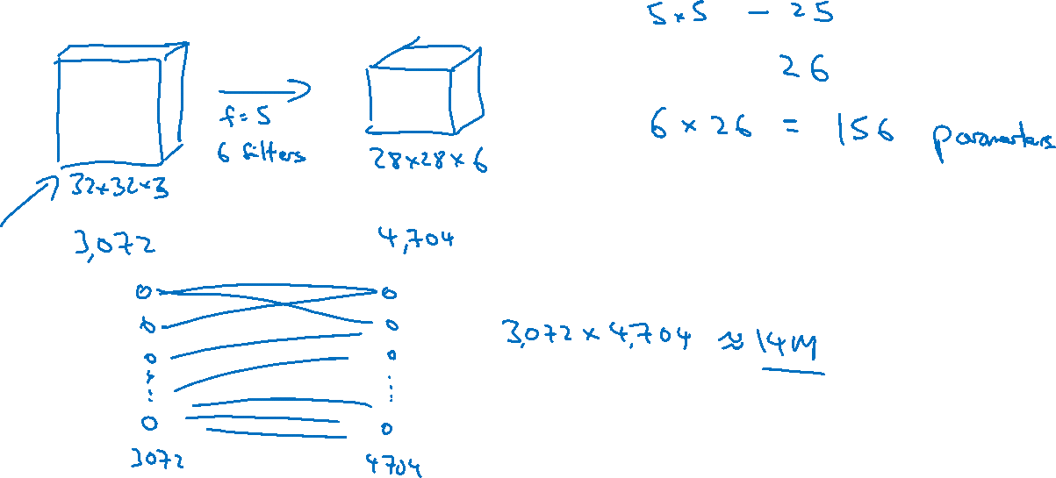
Why convolutions

Slide 3
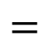

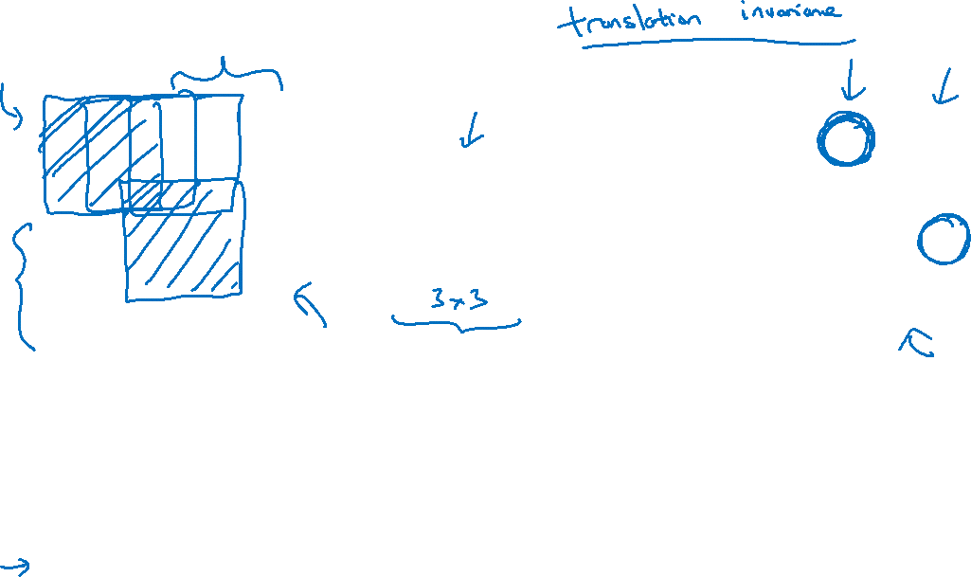
Why convolutions
10 | 10 | 10 | 0 | 0 | 0
10 | 10 | 10 | 0 | 0 | 0
10 | 10 | 10 | 0 | 0 | 0
10 | 10 | 10 | 0 | 0 | 0
10 | 10 | 10 | 0 | 0 | 0
10 | 10 | 10 | 0 | 0 | 0
0 | 30 | 30 | 0
0 | 30 | 30 | 0
0 | 30 | 30 | 0
0 | 30 | 30 | 0
1 | 0 | -1
1 | 0 | -1
1 | 0 | -1
$$∗$$
$$=$$
Parameter sharing: A feature detector (such as a vertical edge detector) that’s useful in one part of the image is probably useful in another part of the image.
Sparsity of connections: In each layer, each output value depends only on a small number of inputs.

Slide 4
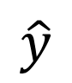

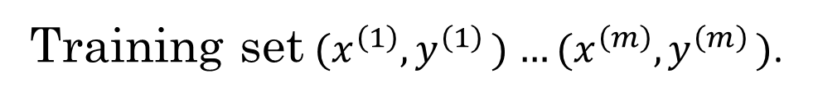
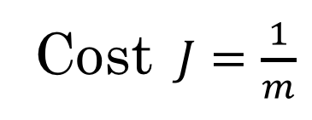

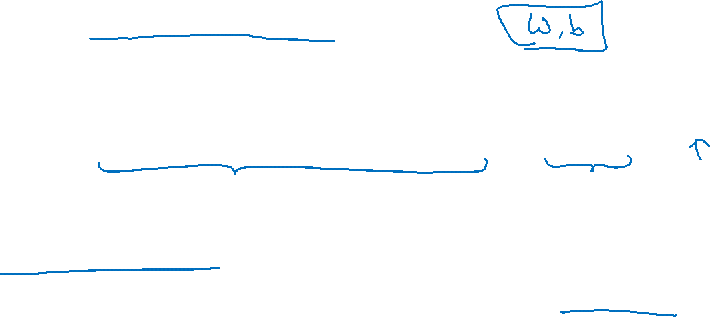

Putting it together
Training set$(x^{\left(1\right)}{,y}^{\left(1\right)})$ $…(x^{\left(m\right)}{,y}^{\left(m\right)})$.
$$\hat{y}$$
Cost $J=\frac{1}{m}$
$$\sum_{i=1}^{m}{ }$$
$$ℒ({\hat{y}}^{\left(i\right)},y^{\left(i\right)})$$
Use gradient descent to optimize parameters to reduce $J$

